Slide 1


Final Assignment
Bruno Andrade Pinto Simoes
Junseob Noh
Robert Routledge
Pavel Sazonov
Saba Sultana
Social Data Mining Techniques – BDAT1007

Slide 2
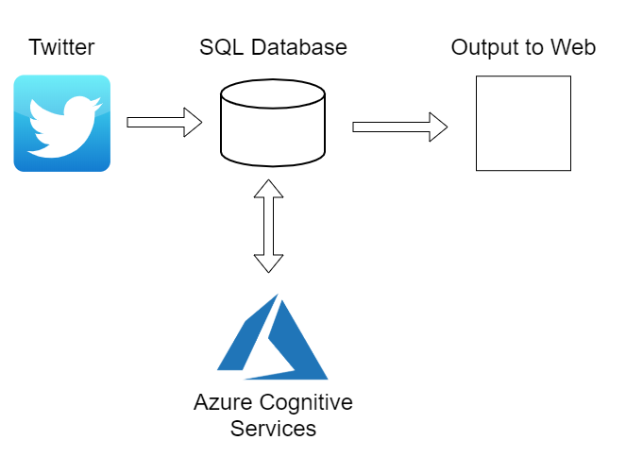
Project Process

Slide 3
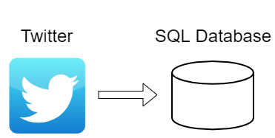
Step One: Scrape Twitter for Data

Slide 4
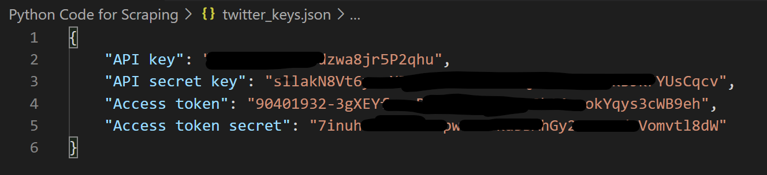
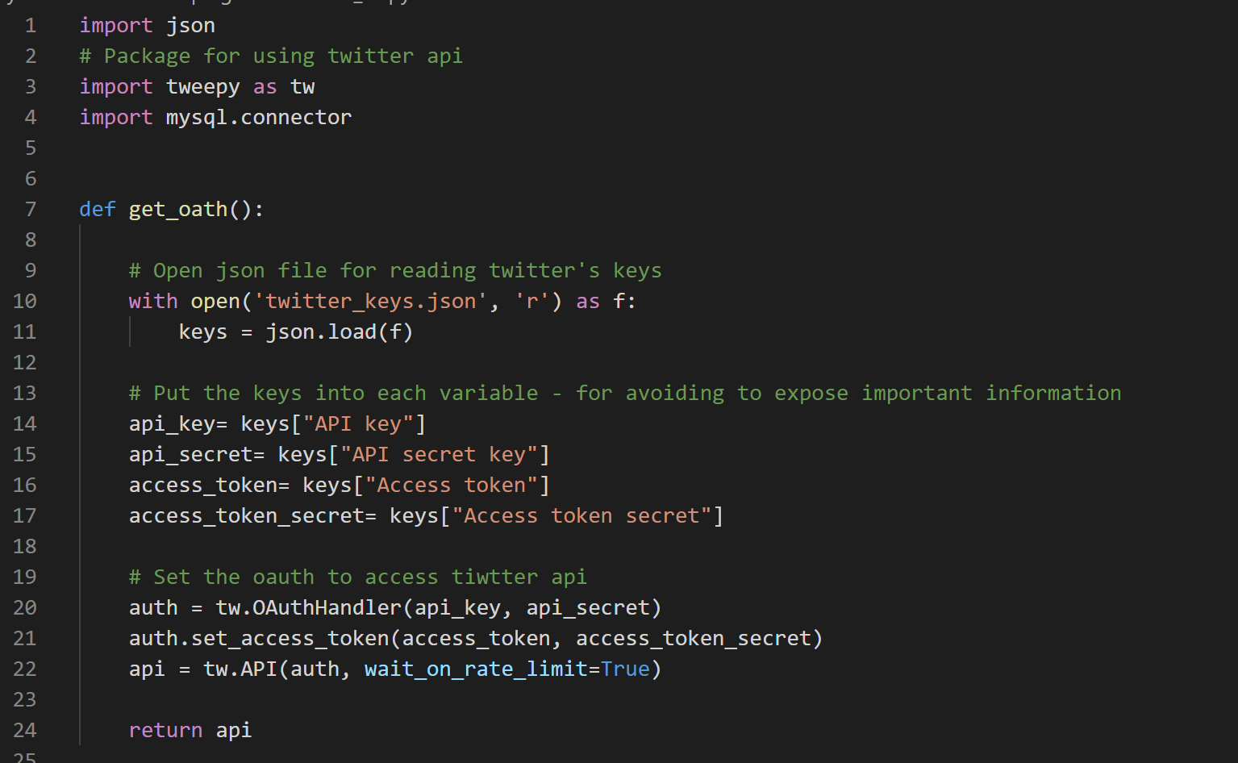

Junseob
How to Get Twitter Data
Access Tweets Using the Twitter REST API
Only access tweets from the last 6-9 days
Only request 18,000 tweets in one call
Twitter Data Access in Python
tweepy package
Store the Data
AWS RDS MySQL Database

Slide 5
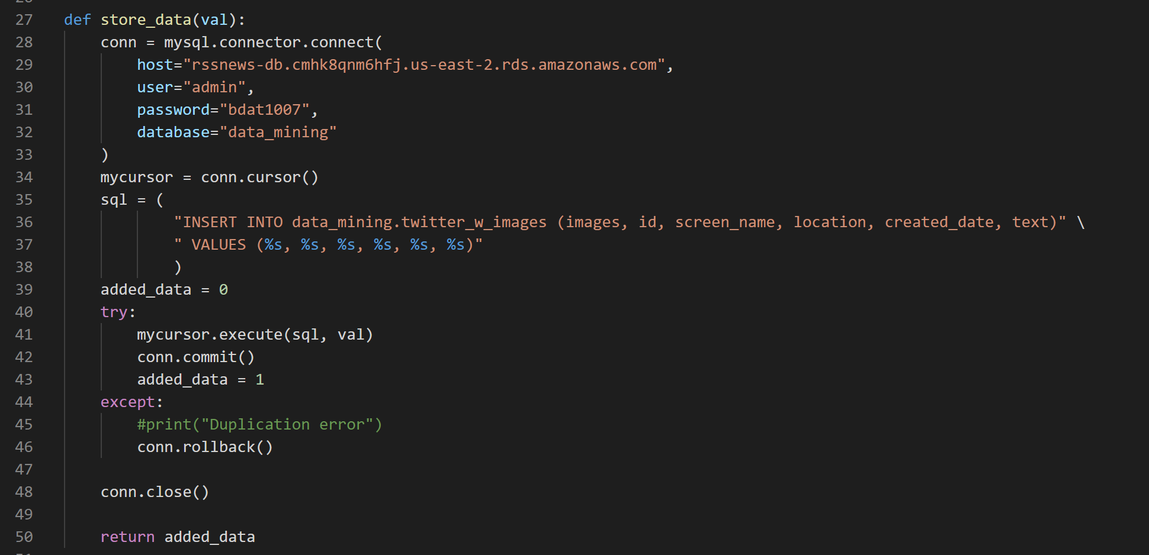
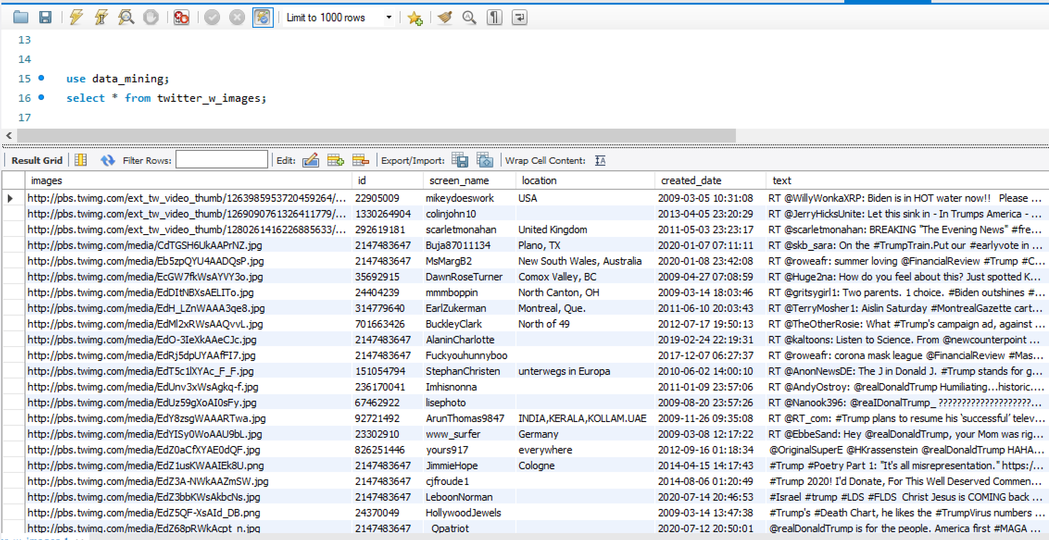

Junseob
How to Store Twitter Data
Amazon RDS
Using MySQL Free-tier

Slide 6
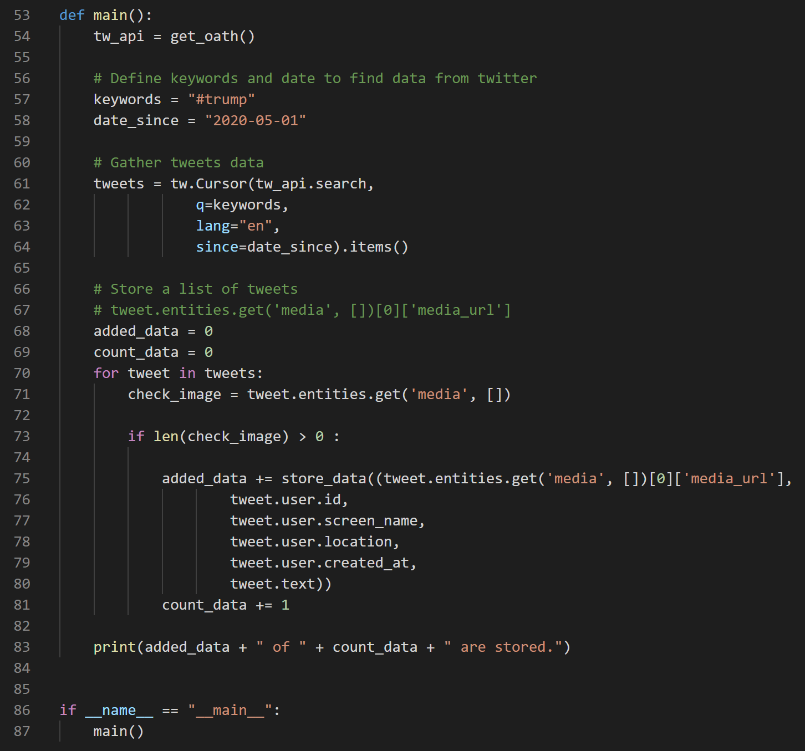
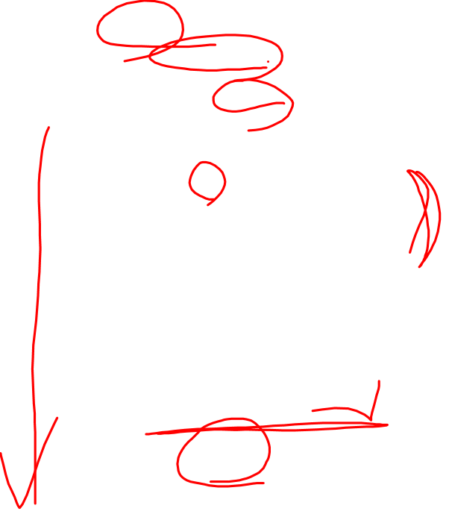
Junseob
How to Run the Code
Keyword for getting data
Trump
Order running program
Get Twitter API using get_oath function
Set keyword using tweepy
Check tweet if it has an image
If there is image, store the data in the database

Slide 7
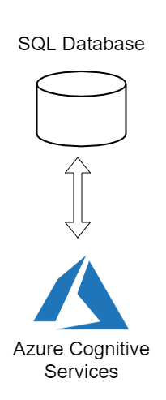
Step Two: Analyze Text and Images

Slide 8
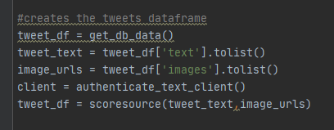
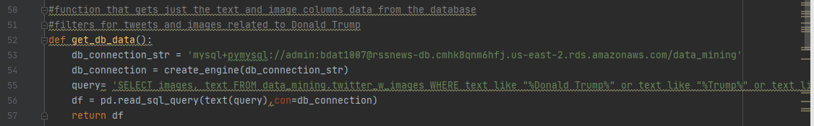
Step Two: Load Data

Slide 9
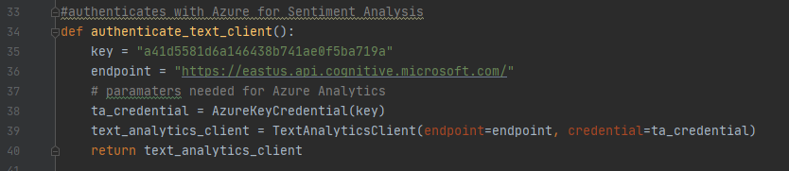
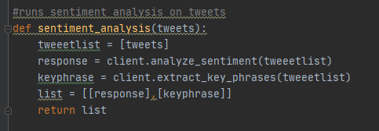

Step Two: Authenticate

Slide 10
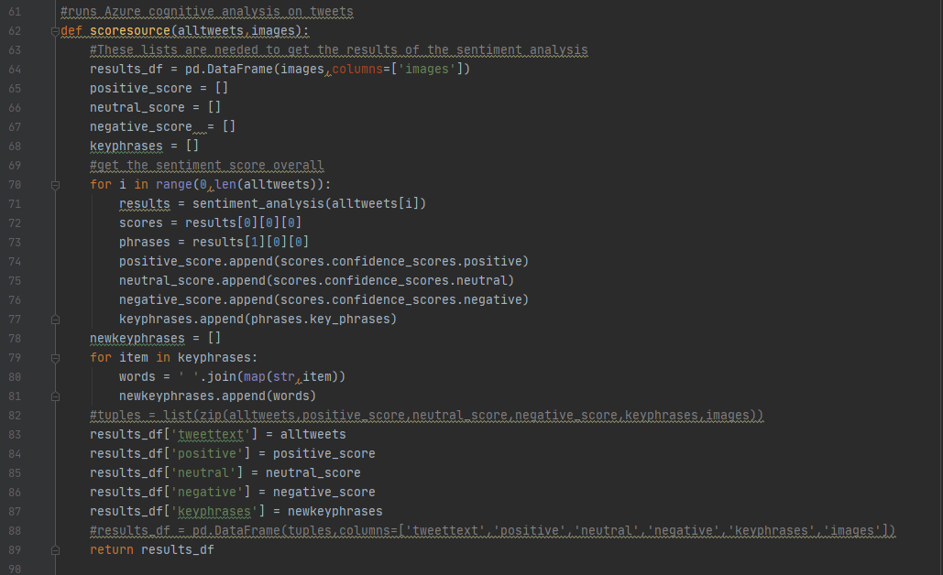
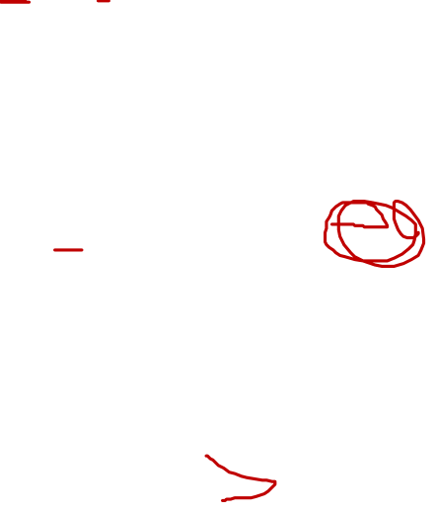
Step Two: Analyze Text

Slide 11
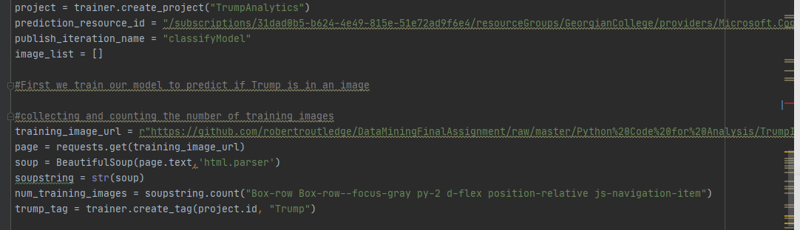
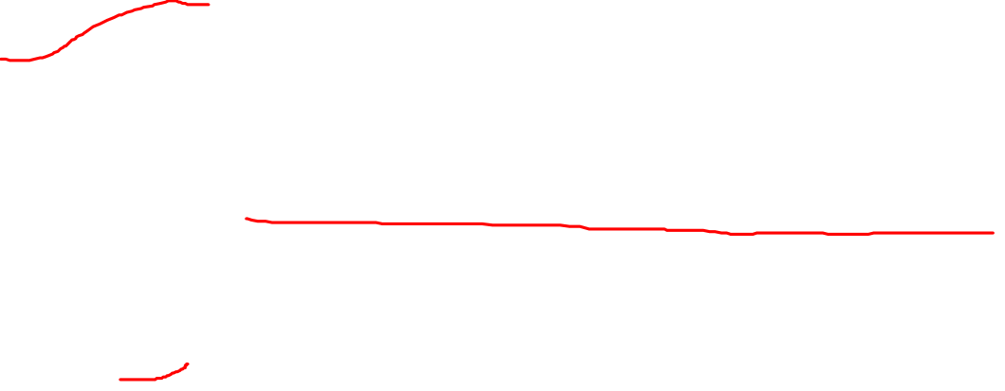
Step Two: Scrape Training Data Library for Training Images

Slide 12
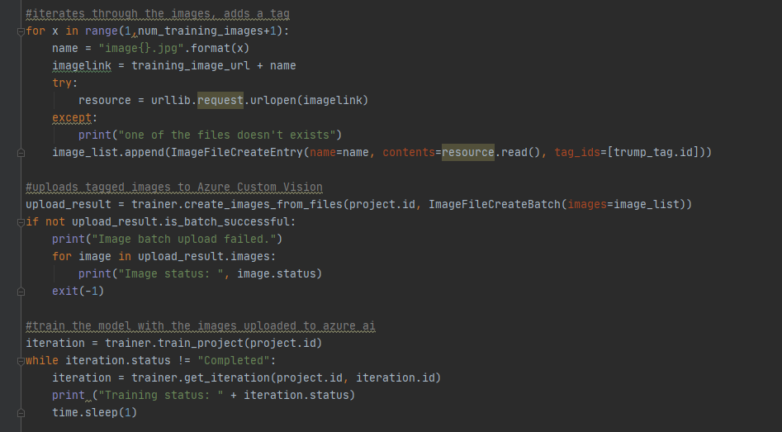

Step Two: Train Images using Azure CustomVision.ai

Slide 13
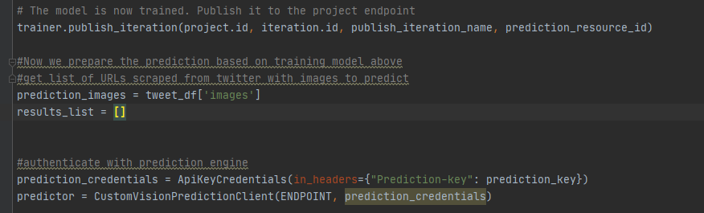
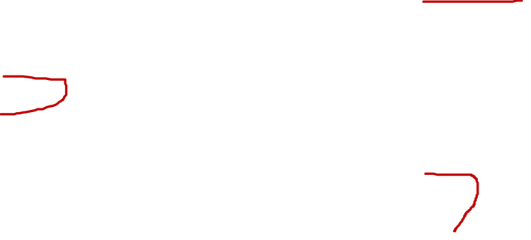
Step Two: Publish Trainer and Authenticate Prediction

Slide 14
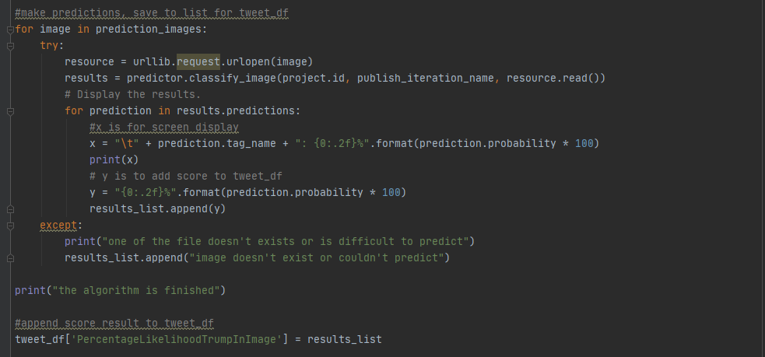

Step Two: Run Images from Twitter for analysis

Slide 15
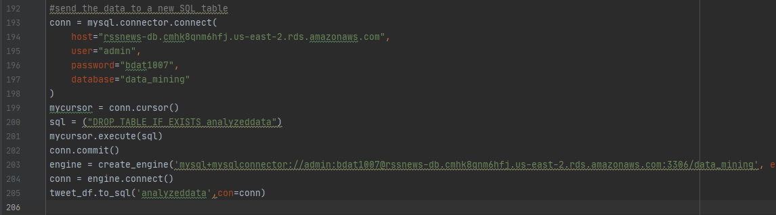
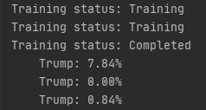
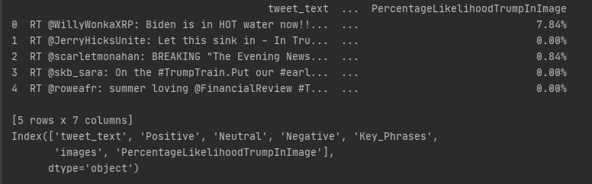

Step Two – Final Dataframe output

Slide 16
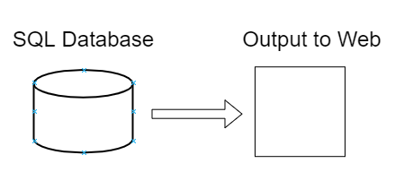
Display Results

Slide 17
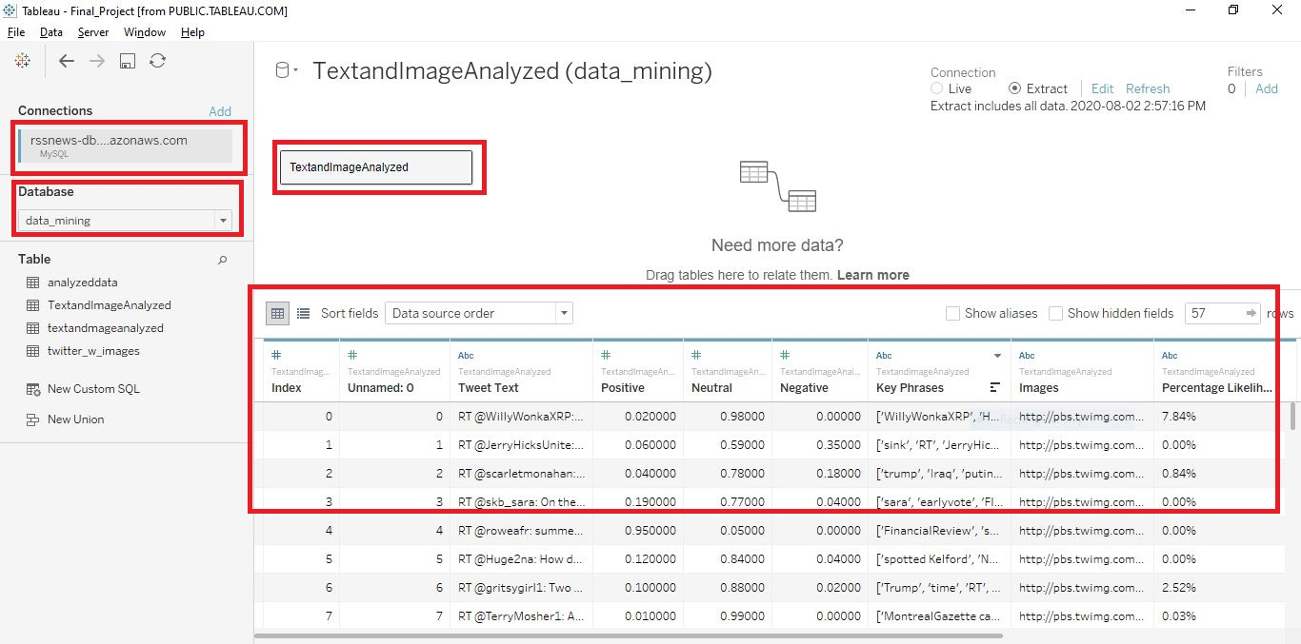
Tableu Data Sourcing

Slide 18
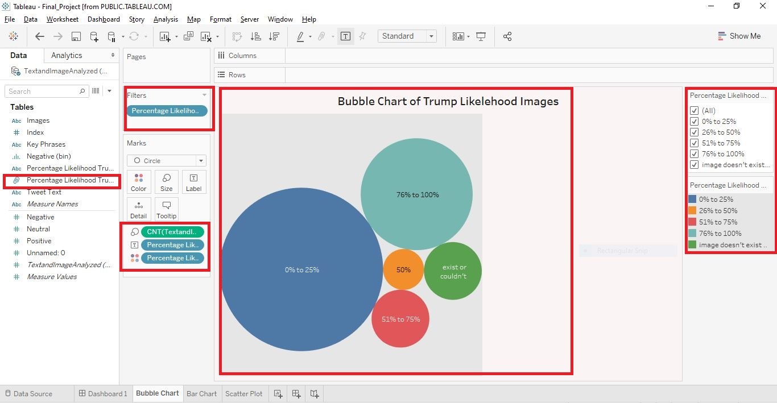
First Analysis – Bubble Chart of Trump Likelihood on Image

Slide 19
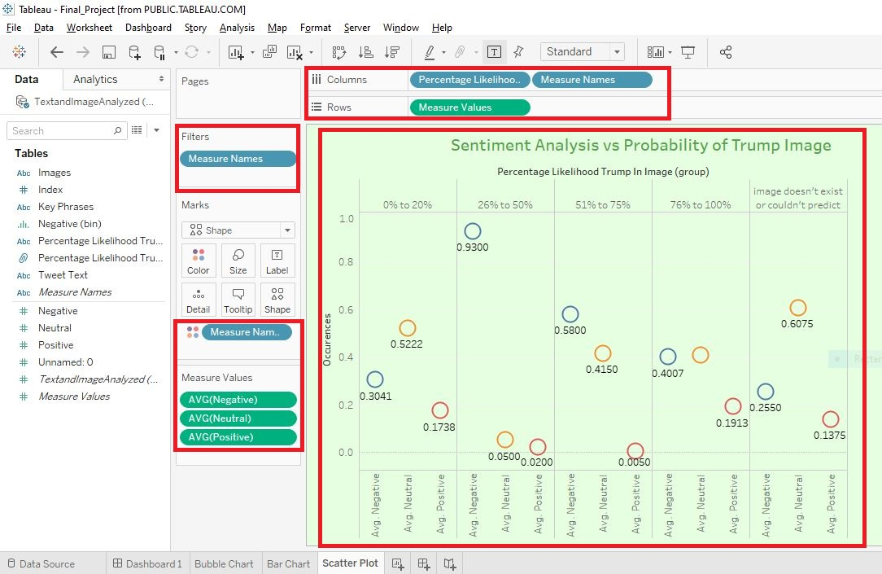
Scatter Plot – Image Likelihood vs Sentiment Analysis

Slide 20
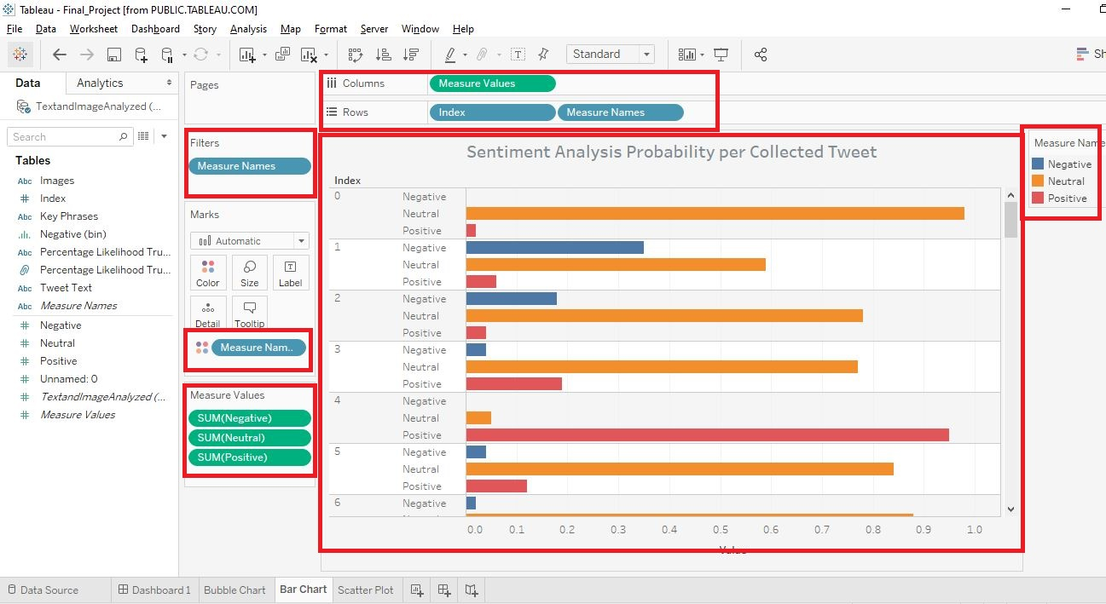
Bar Chart – Sentiment on Every Tweet

Slide 21
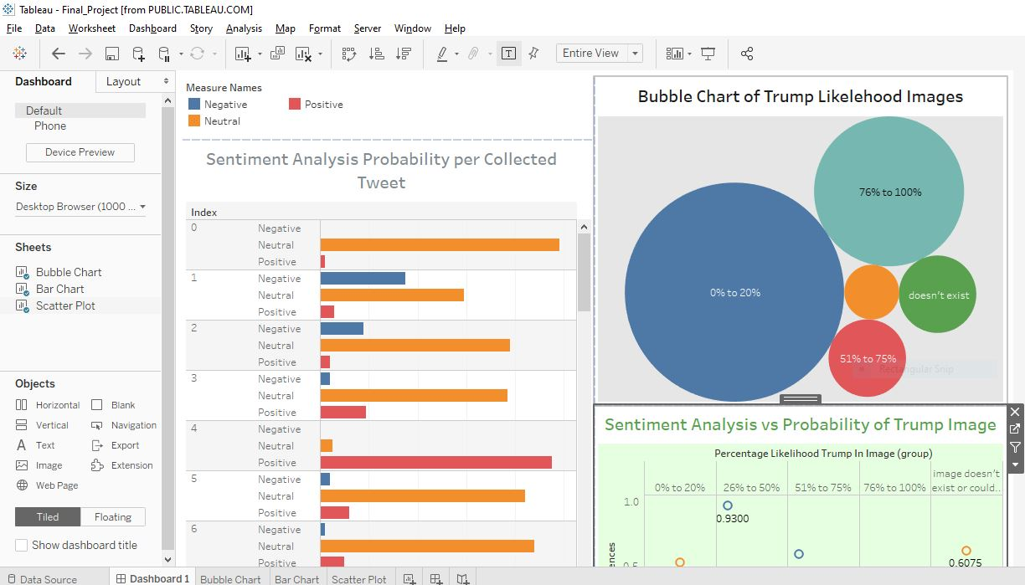
Tableau Dashboard

Slide 22
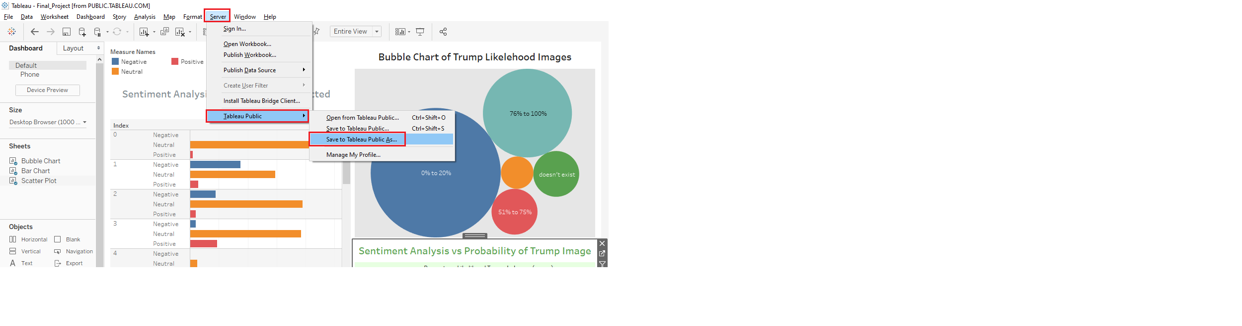
Tableau Public

Slide 23
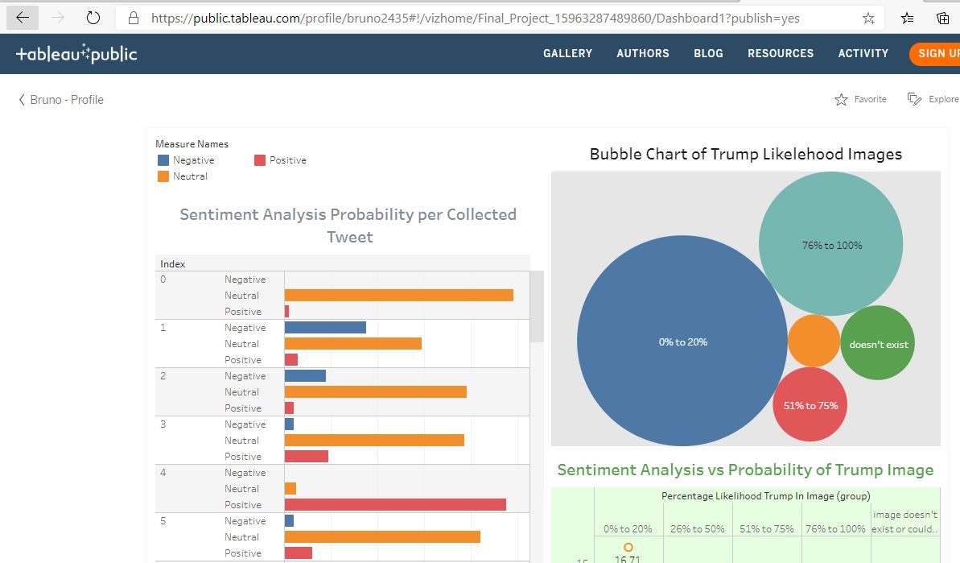
Tableau Public Web
https://public.tableau.com/profile/bruno2435#!/vizhome/Final_Project_15963287489860/Dashboard1?publish=yes

Slide 24
Thank You

